Slide 1
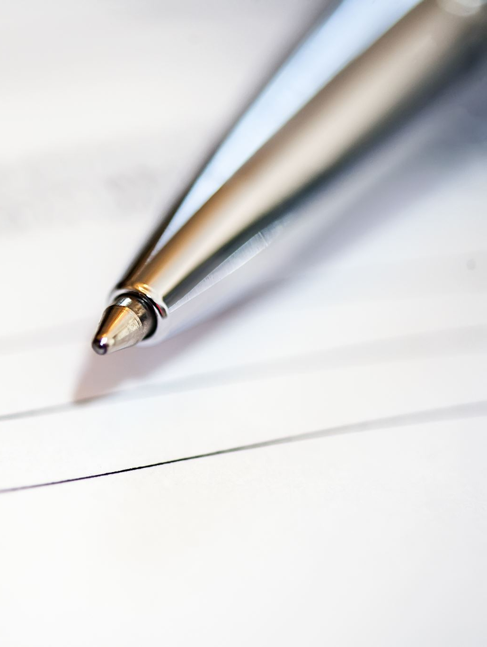
Hand Written Letter Recognition
GROUP 12
E/16/086 -Virajani Dharmathilaka
E/16/156 -Tharushini Jayathilaka
E/16/223 -Chanika madushanki

Slide 2
Background
Dataset - 372450 images of alphabets(784 columns of pixel data)
Splitting – Images and labels
Reshaping – Testing and Training , 28x28 pixels, can be displayed as images
(80% - train, 20% testing)
Label data with integers
Dictionary to map the integer values with the characters.
Convert the single float values to categorical values

Slide 3
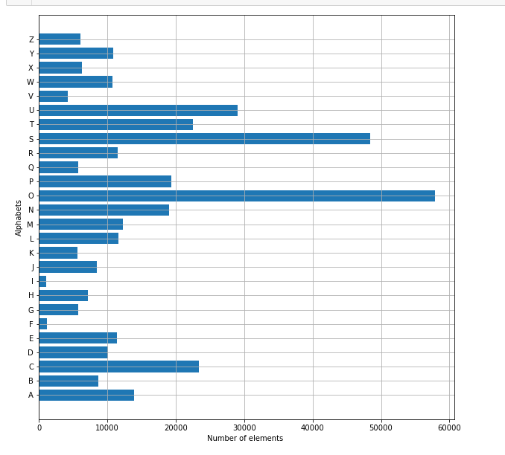
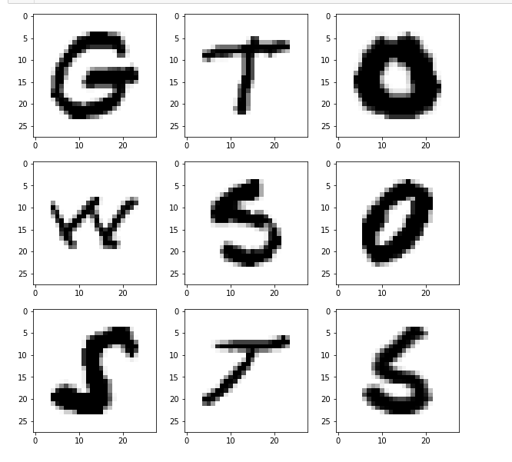
DataSet Distribution count and alphabet list

Slide 4
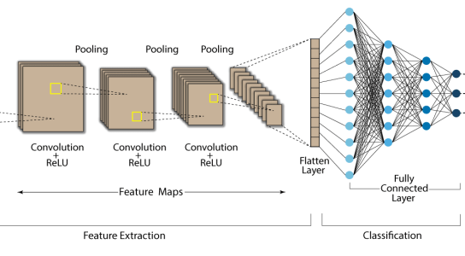
Architecture
3 convolution layers with 3 fully connected layers
input
output

Slide 5
Problems occurred
Overfitting
Underfitting
High training time
Solutions
Choose suitable ,
activation functions
Number of epochs
Pooling function

Slide 6
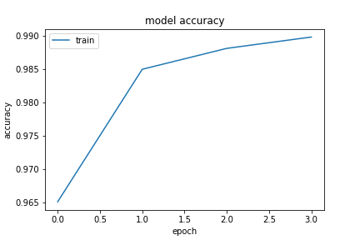
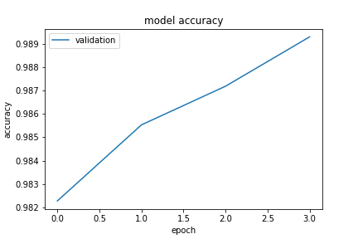
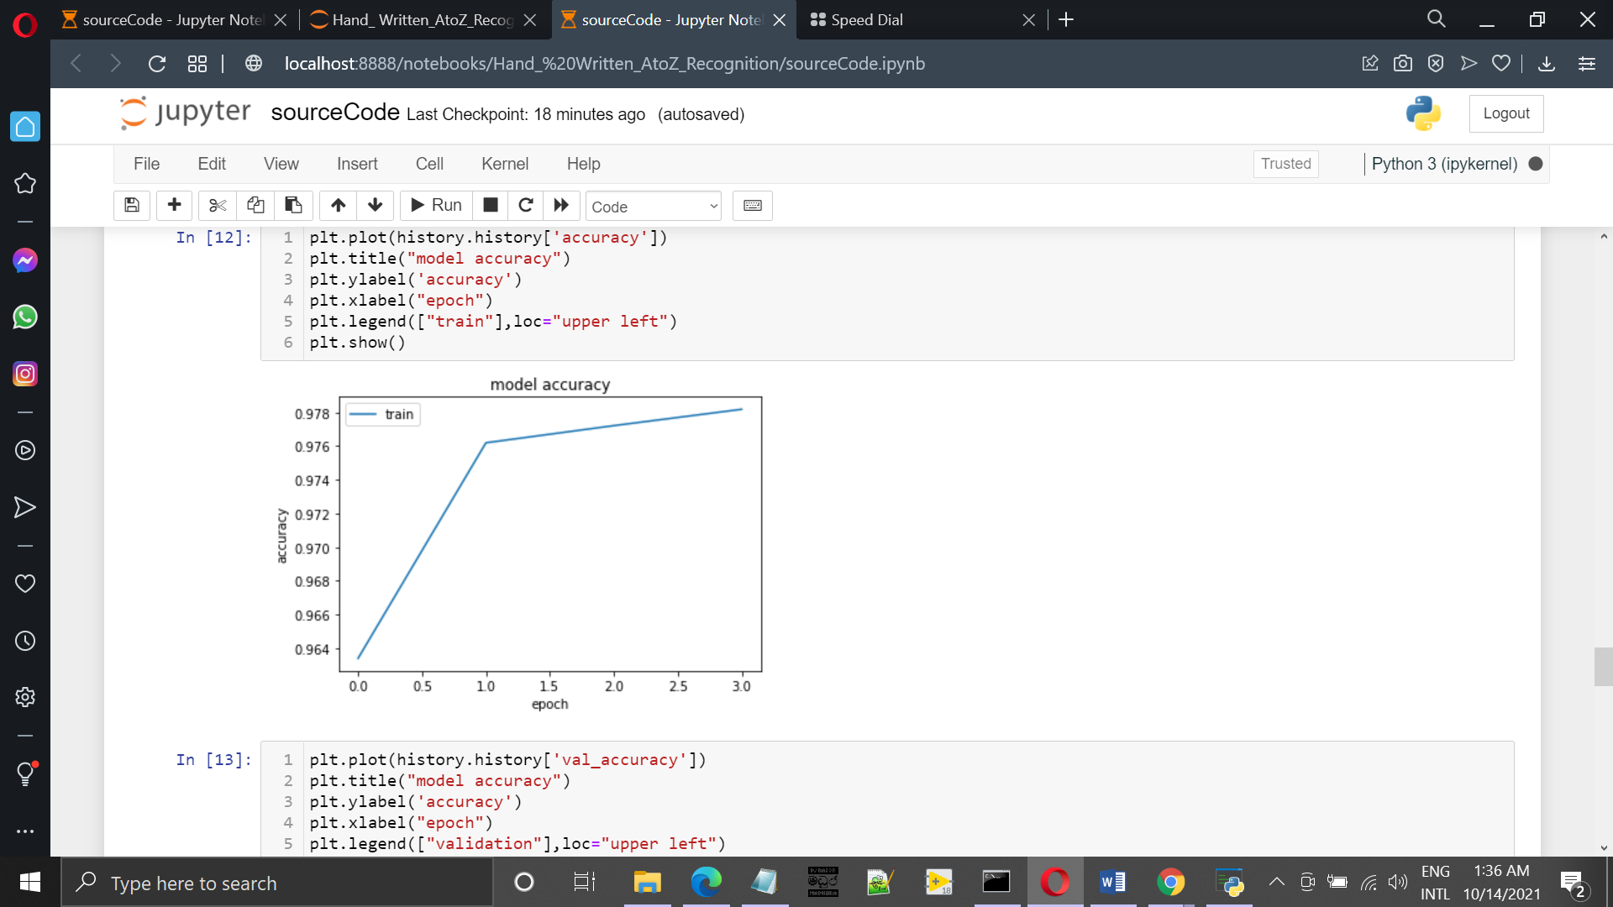
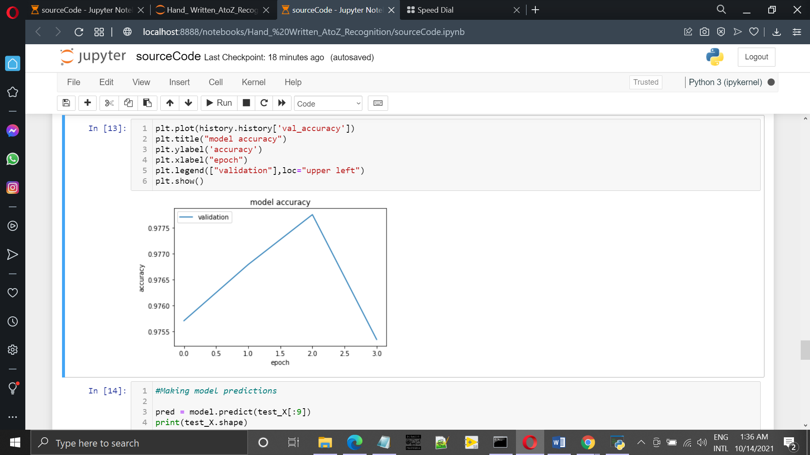
Choosing Activation Functions
ReLU, tanh functions
 | Training Accuracy(%) | Validation Accuracy(%) | Training Loss(%) | Validation Loss (%)
ReLU | 98.9847 | 98.9287 | 3.6027 | 4.2210
tanh | 97.8181 | 97.5338 | 7.5377 | 8.3825
tanh
tanh
ReLU
ReLU

Slide 7
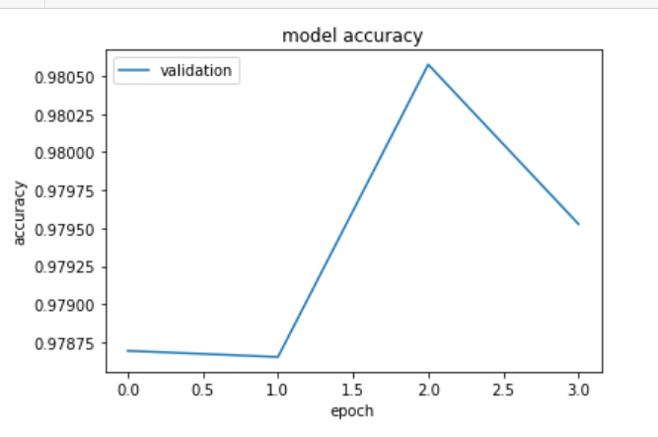
Choosing Pooling Function
Average pooling, Max pooling
 | Training Accuracy(%) | Validation Accuracy(%) | Training Loss(%) | Validation Loss (%)
Average pooling | 98.9847 | 98.9287 | 3.6027 | 4.2210
Max pooling | 98.4685 | 97.9527 | 5.5480 | 7.8789
Average pooling
Max pooling

Slide 8
No. Of epochs
No. Of epochs | Training Accuracy(%) | Validation Accuracy(%) | Training Loss(%) | Validation Loss (%)
1 | 96.3176 | 98.4118 | 5.2855 | 5.9449
2 | 98.4484 | 98.7649 | 5.5186 | 4.6387
4 | 98.9572 | 98.7528 | 3.6766 | 4.9140

Slide 9
Other techniques
'softmax' activation function for final layer
Early Stopping
Fine tuning learning rate
Use Adam optimization function
Reduce learning rate when a metric has stopped improving

Slide 10
Predictions
Predictions on Test Data
Test Dataset - 74490 images of alphabets
Prediction on External Image

Slide 11
Predictions on Test Data
Create 9 subplots of 3,3 shape
Flattened them to 1D array
Reshape and convert the image to grayscale
Make prediction to get the index of the class with the highest predicted probability

Slide 12
Prediction on External Image
Read an external image and made a copy of it
To display
To be fed to the model
Convert the image from BGR to RGB
Do some processing on the copied image
Convert the image from BGR to grayscale and apply thresholding
Resize and reshape
Make prediction using the processed image to get the index of the class with the highest predicted probability

Slide 13
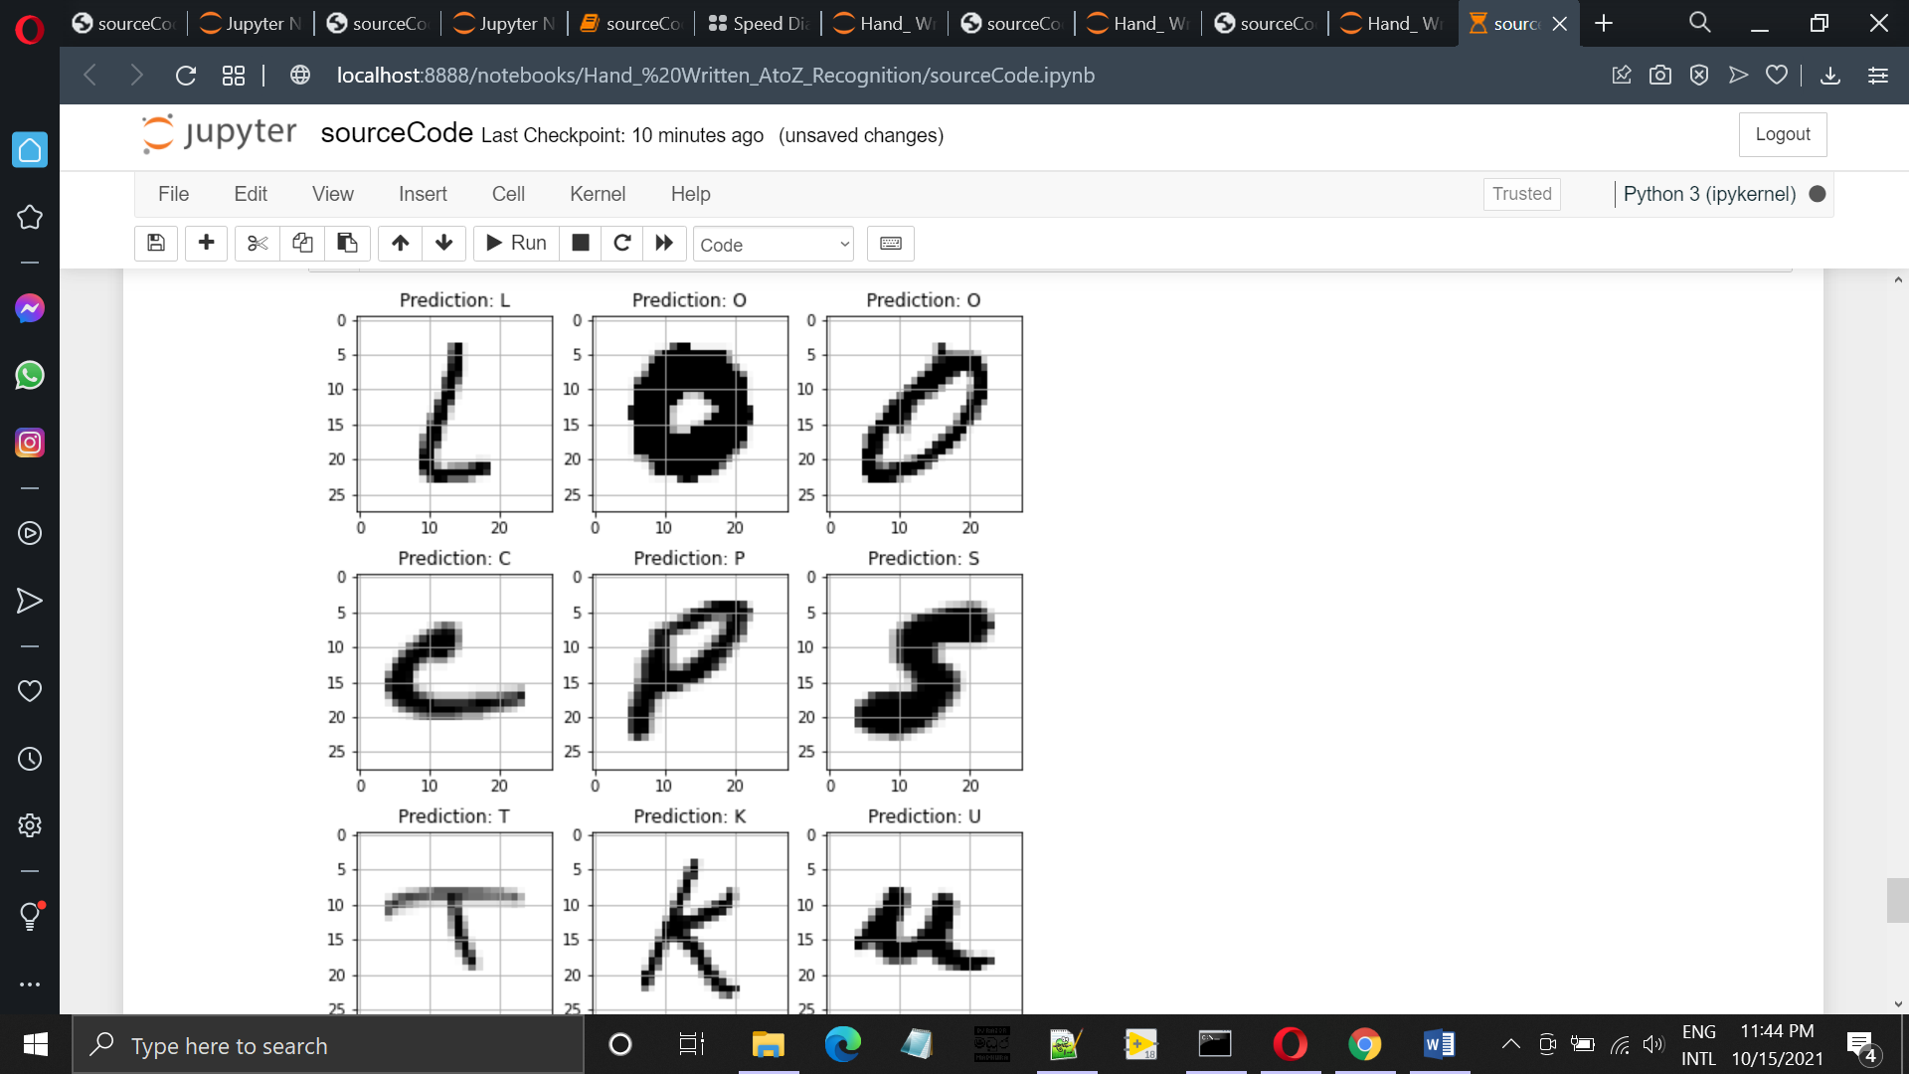
Prediction result on Test Data

Slide 14
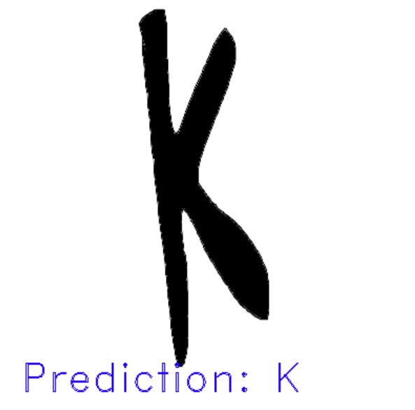
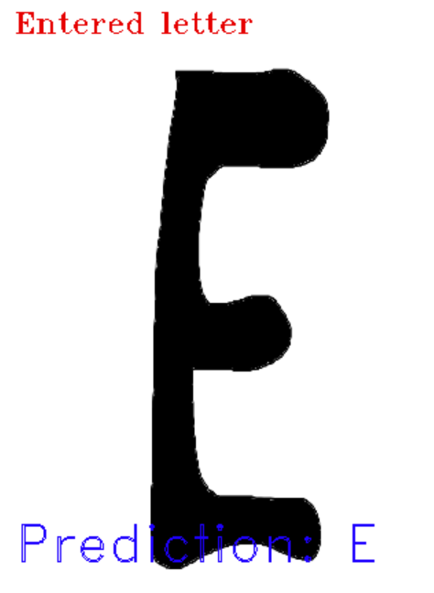
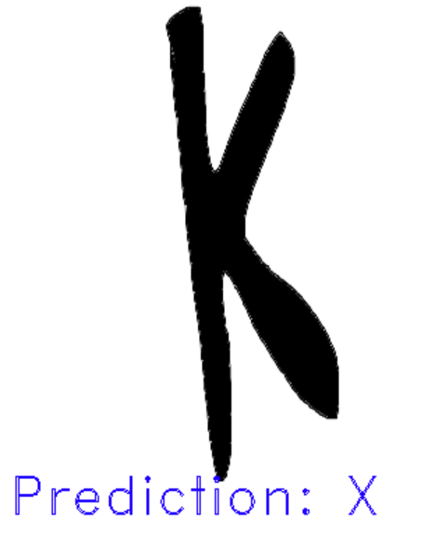
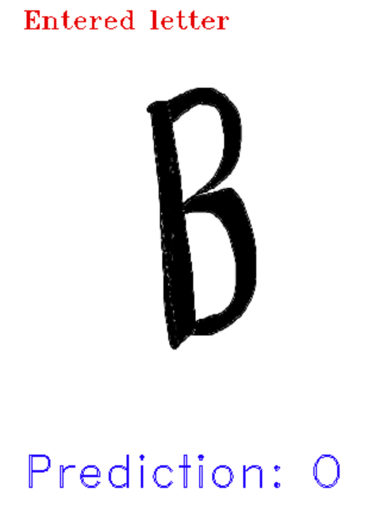

Prediction results on External Images

Slide 15
Thank you

Slide 16
Q&A

